Slide 1
Water Pump Demo: GUI and Arduino setup
USTC
6/17/25

Slide 2
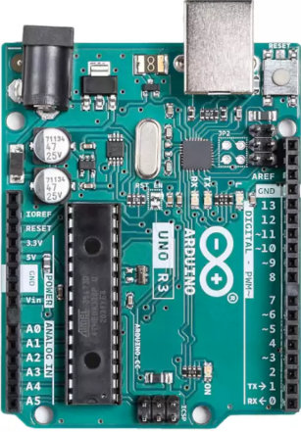

Arduino UNO Connections
GND and 5V: use to power up DS12B80 Temp sensors And other Flow Meter
To LAPTOP (always needed for GUI ⬄Arduino)
Pin2: From Flow Meter (counting pulses)
Pin 3: From EVK “SOUT”
(counting pulses)
Pin 4: From DS12B80 (Inlet Temp) Pin 5: From DS12B80
(Outlet Temp)
Pin 10: PWM out (to EVK “PWMIN”)
490Hz fixed, changing duty cycle

Slide 3
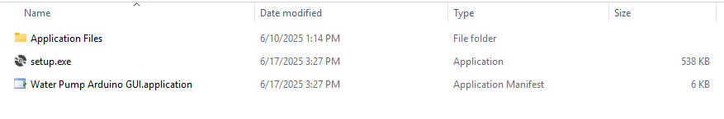
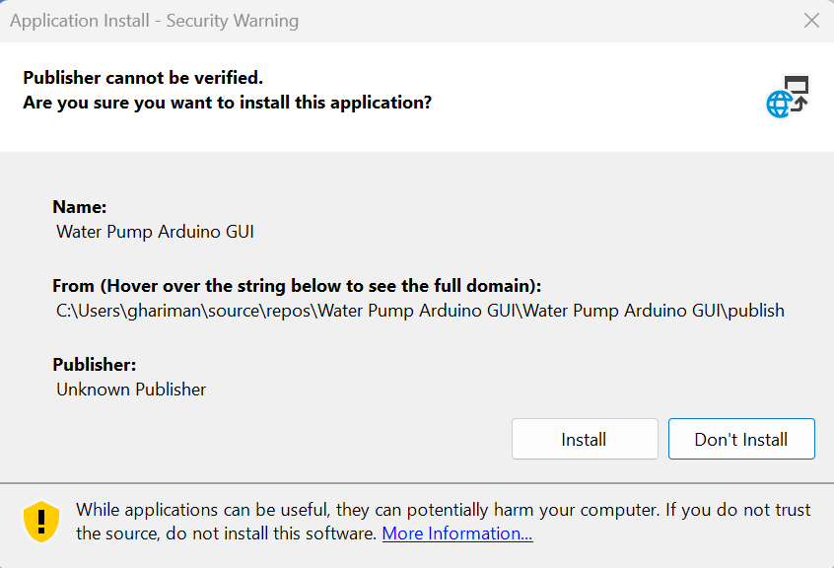
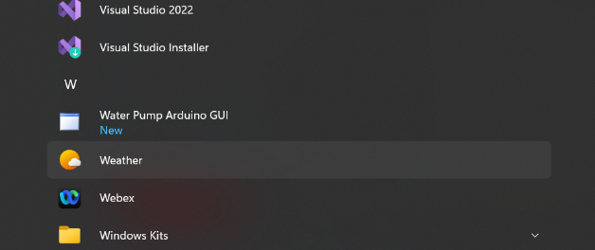
GUI Installation
#1
#3: find it in programs
#2

Slide 4
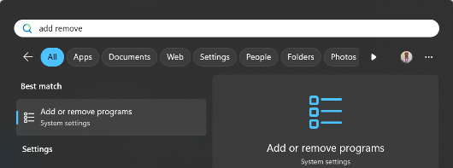
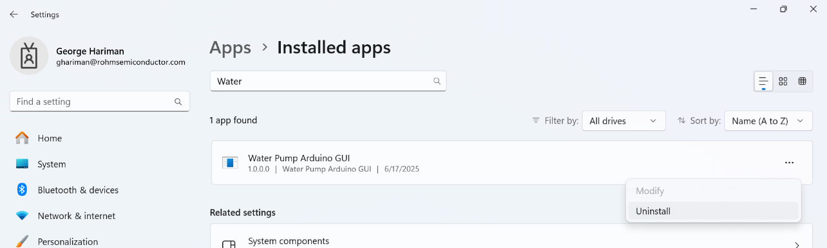
GUI Un-Install
Need to un-install already existing GUI, if a new updated GUI needs to be installed
#1: search “Add or Remove Programs” in Windows
#2 And then in this search, for “Water Pump”
#3
#4

Slide 5
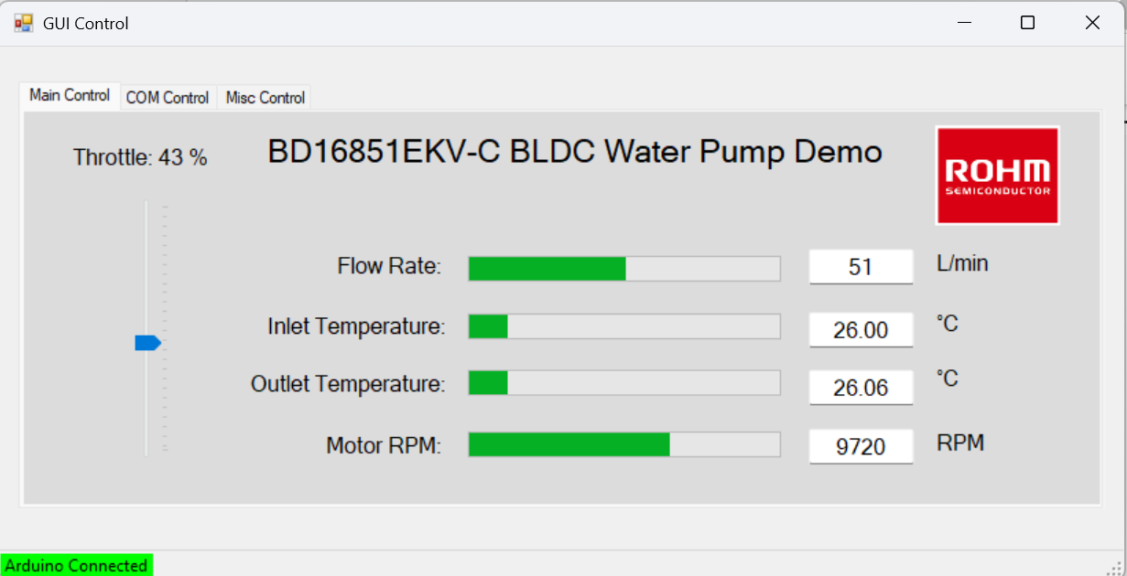
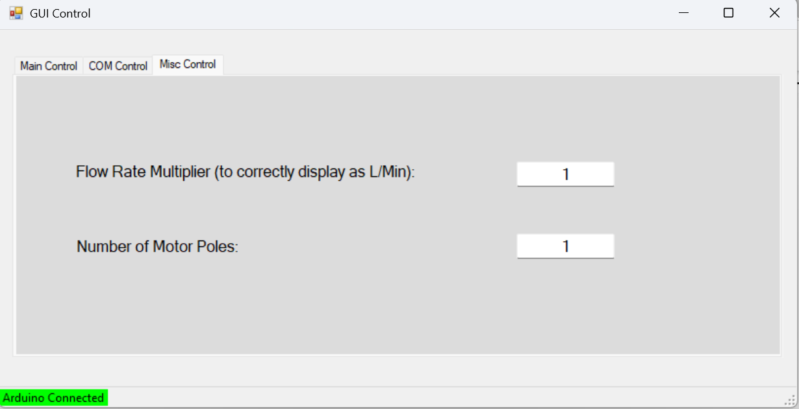
GUI: MISC Control Tab (DO THIS FIRST to avoid GUI overflow)
Main Tab
The MISC Tab has a multiplier for the Flow Rate, and number of Poles for the RPM. Now the multiplier will be remembered from session to session.
The value reported on the Flow Rate in the Main Tab are pulse counted from Arduino and multiplied by the ratio in the MISC Tab. Similarly the RPM is adjusted based on the entered number of Poles.
Change the number in MISC Tab, to adjust accordingly to get the correct conversion from pulses (Hz) to L/min and RPM shown in Main Tab
MISC Tab

Slide 6
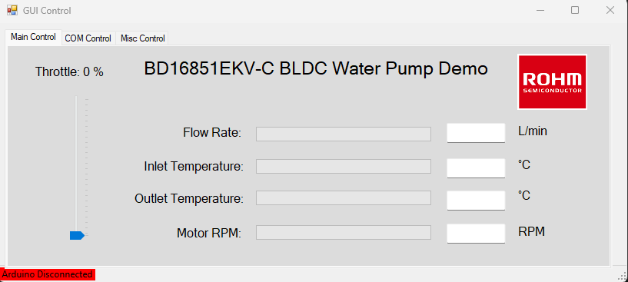
GUI: Main Control Tab (before connected)
Before connected
To connect, go to “COM Control” tab. See next page

Slide 7
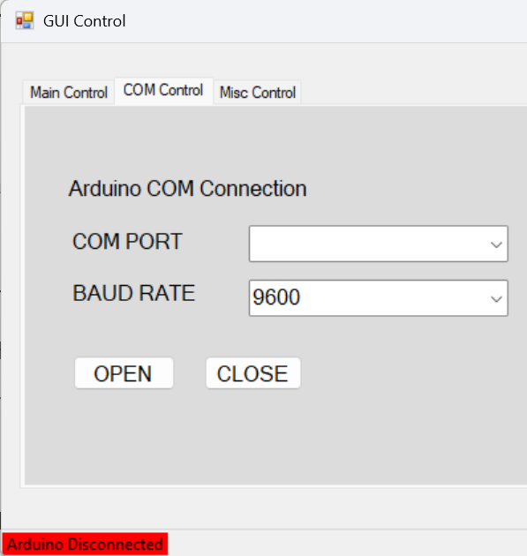
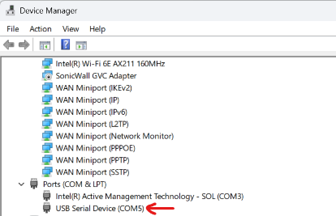
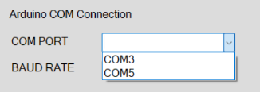
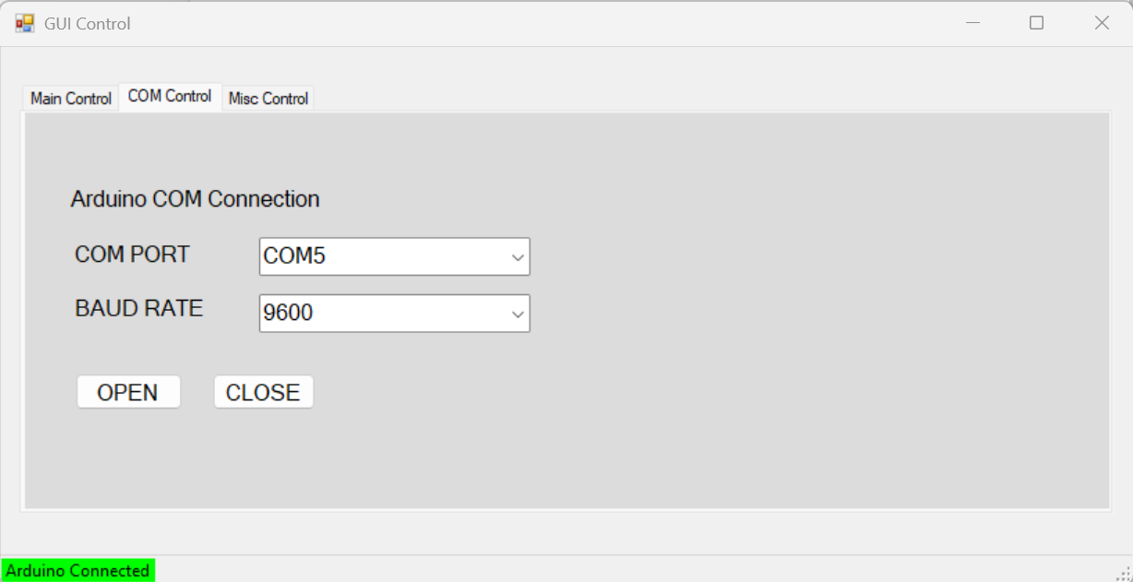
GUI: COM Control Tab
Before connecting
Note: Arduino code baud rate currently set at 9600
Open up Device Manager and figure out which COMx port is Arduino Uno connected. In this example it happens to be COM5. It probably will be different on your computer.
Then select that particular selection in GUI. Then press “OPEN” to connect to Arduino.
After connected

Slide 8
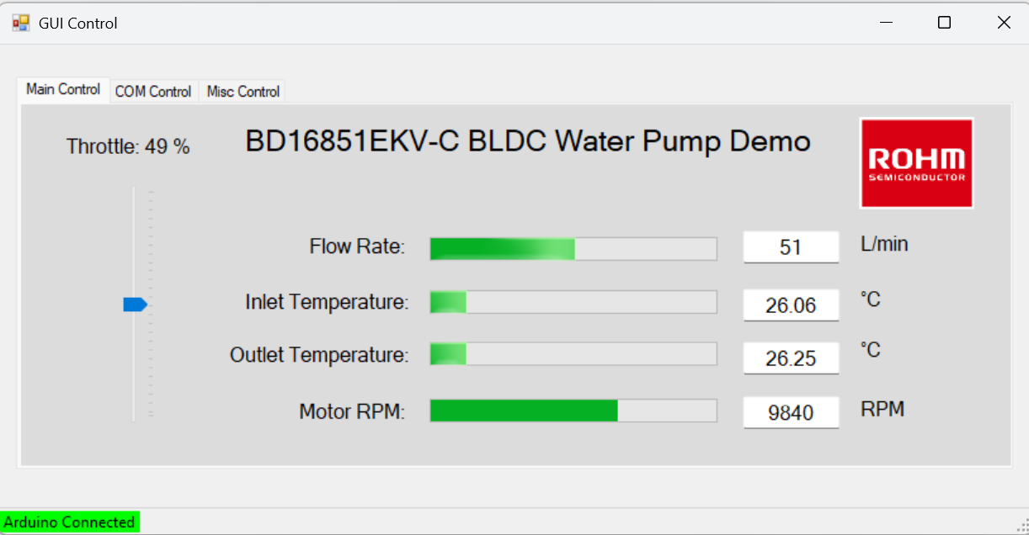
GUI: Main Control Tab (after connected)
After connected
Move this Track Bar
using mouse to change the PWM duty cycle
These are readings from the various sensors Note: see MISC Tab explanation page

Slide 9
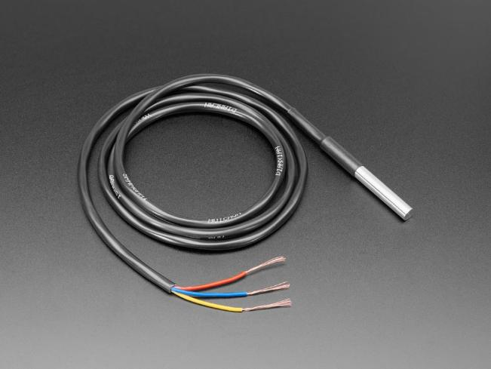
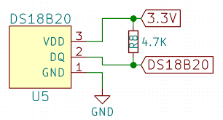
DS12B80 Waterproof Temp sensor
https://www.adafruit.com/product/381?srsltid=AfmBOoooli1XO_yppyBPyvpcBWYL0KMoVCed8fbv0-zbDvSYs38vISJ9
Remember 4.7k pullup!
5.0V
To Arduino

